Slide 1

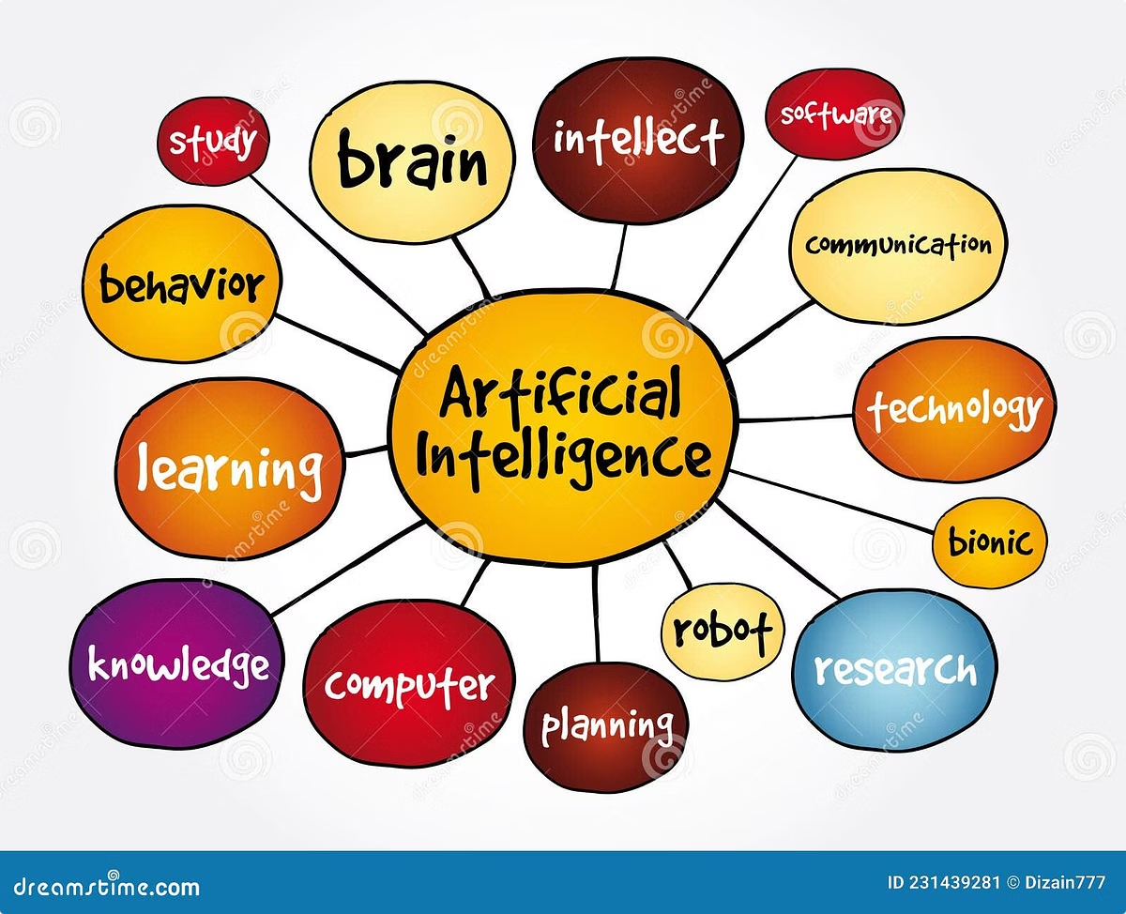
Real-Time Anomaly Detection In Financial Transaction Using AI
Real-Time Anomaly Detection in Financial Transactions using AI provides
immediate fraud detection by analyzing large-scale transaction data and
identifying suspicious patterns.

Slide 2


Challenges of Real-Time Anomaly Detection
1
Data Volume and Speed
Handling vast quantities of data in real-time.
2
Anomaly Rarity
Rare occurrences make detection difficult.
3
False Positives and Negatives
Balancing accuracy with minimal impact.
4
Scalability and Latency
Efficiently processing data in a timely manner.

Slide 3
Proposed Approach: AI-Powered Anomaly Detection
System Architecture
Key Techniques
Streaming Data Handling
Data Collection, feature extraction, model building.
Data ingestion on Apache Kafka
Random Forest,Isolation Forest,
ANN.
Efficient processing of continuous data streams.
And Prediction on real time streaming data.

Slide 4

Data Sources for Anomaly Detection
1. Financial Transaction Logs
Network Traffic Logs
Monitoring network activity for unusual patterns.
Detecting fraudulent or suspicious financial activity.
2. Paysim Dataset:
The PaySim dataset simulates financial transactions based on
real-world mobile money services, providing a large, Anonymized
dataset for detecting fraudulent behavior,featuring various
transaction types, amounts, and timestamps for training
machine learning models.

Slide 5
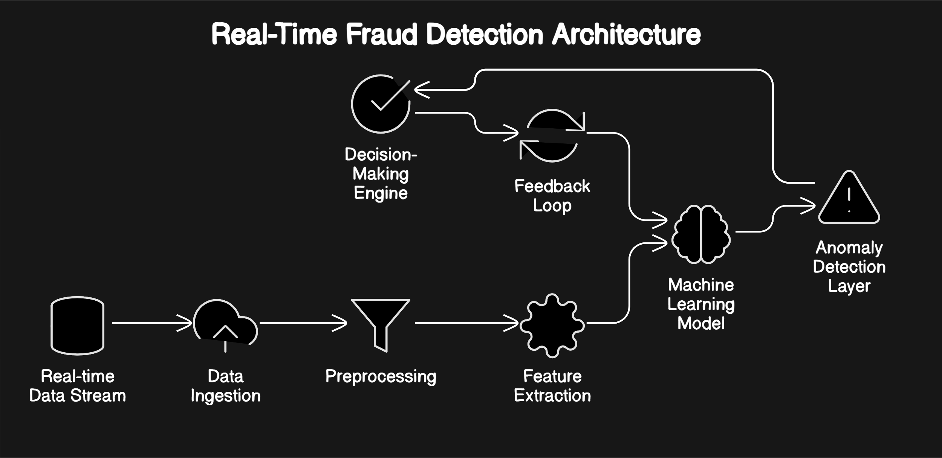

Slide 6
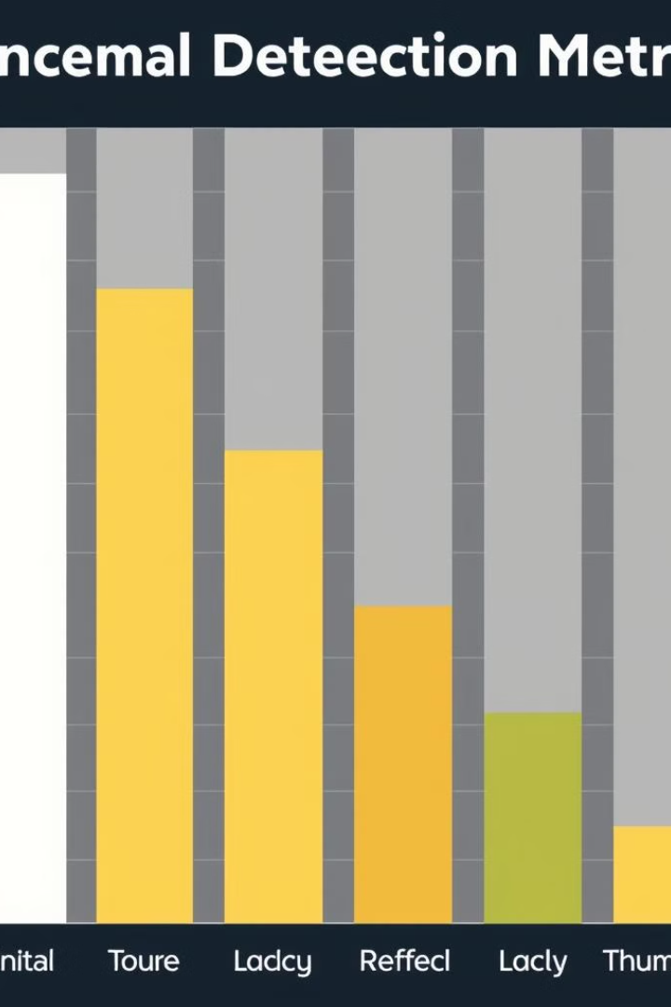




Evaluation Metrics for Anomaly Detection
Precision
Percentage of correct anomaly predictions.
Recall
Percentage of actual anomalies identified.
Roc AUC Score
It is based on ROC curve which plots the True Positive Rate against False Positive Rate
Accuracy
How well our model Performing

Slide 7
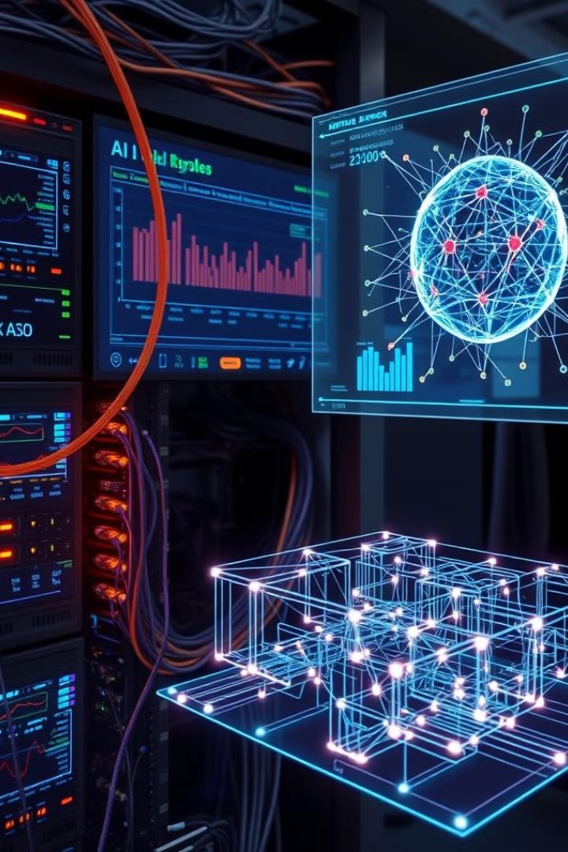
Implementation and Deployment
1
Deployment
Cloud-based or edge deployment.
2
Real-Time API
Providing continuous anomaly detection services.
3
System Integration
Connecting to existing systems and workflows.
4
Monitoring and Updates
Continuously evaluating and improving the model.

Slide 8
Conclusion:
Real-time anomaly detection using AI revolutionizes financial security by enabling rapid identification of fraudulent activities. By continuously analyzing transaction data, this approach helps reduce risks, improve decision-making, and protect assets, offering a scalable and efficient solution for combating financial fraud.

